Slide 1

Joint Bilateral Learning for Real-time Universal Photorealistic Style Transfer
Eylon Ben Simon
Saar Victor
Gal Toledano
Shiraz Karov

Slide 2
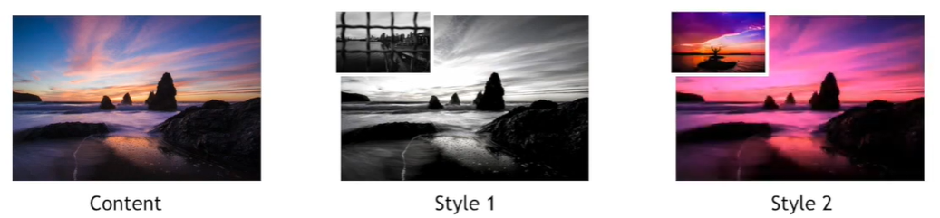
The problem
Transfer a styled photo and paste it onto an input image, so that the output image will be at a high quality which will be equal to the notion that the output photo was taken from a high-resolution camera

Slide 3
The main goals
Universal photorealistic style transfer
Inference implementation that runs at 4K on a mobile phone.
Inference implementation that runs In real time.

Slide 4
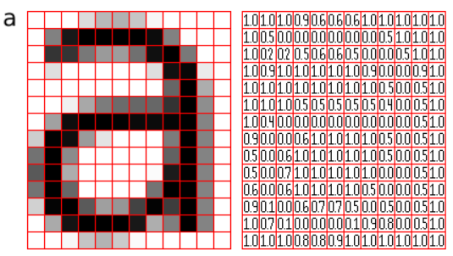

CNN
Convolutional Neural Network
A network that employs a mathematical operation called convolution. Convolution is a specialized kind of linear operation. Convolutional networks are simply neural networks that use convolution in place of general matrix multiplication in at least one of their layers.

Slide 5
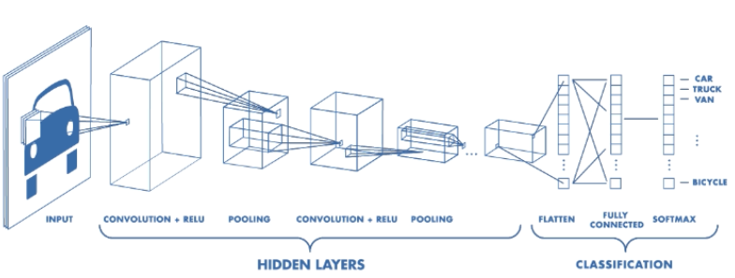
CNN Architecture

Slide 6

Convolutional layer
A CNN is a neural network with some convolutional layers(and some other layers).
A convolutional layer has several filters that does convolutional operation.

Slide 7
Motivation behind convolution
Convolution leverages three important ideas that motivated computer vision researchers: sparse interaction, parameter sharing, and equivariant representation. Let’s describe each one of them in detail.

Slide 8
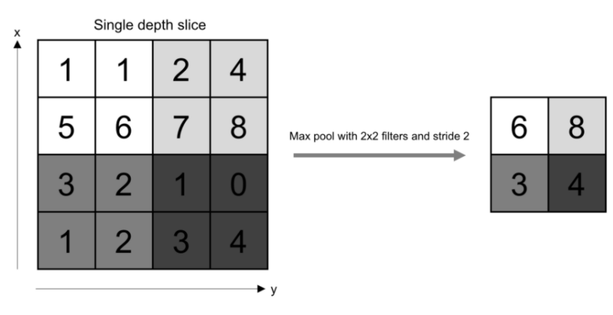
Pooling layer

Slide 9
Fully connected layer
1 | 0 | 0 | 0 | 0 | 1
0 | 1 | 0 | 0 | 1 | 0
0 | 0 | 1 | 1 | 0 | 0
1 | 0 | 0 | 0 | 1 | 0
0 | 1 | 0 | 0 | 1 | 0
0 | 0 | 1 | 0 | 1 | 0
Fully-connected
……
……

Slide 10
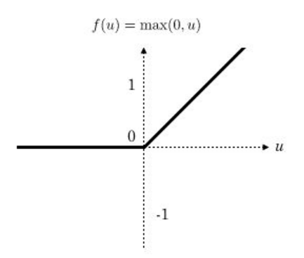
Activation function: ReLu

Slide 11
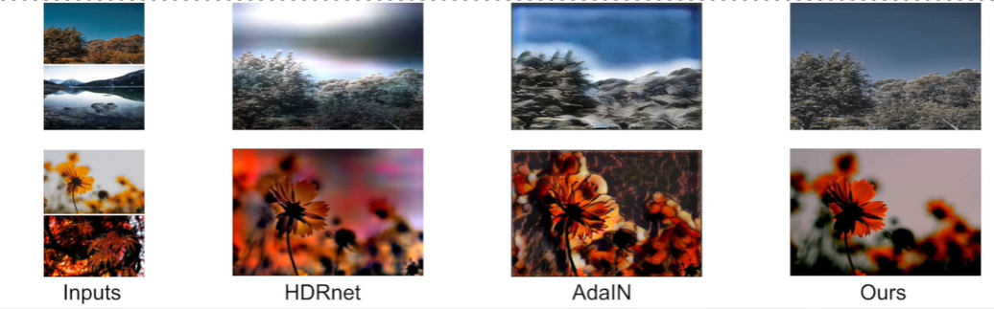
The solution
To combine two other methods specializing in photos manipulation. The first one, Adain which is used to transfer an abstract style onto a photo by transferring feature statistics and generalizing unseen inputs. The second one, HDRNet, which detects edges to an impressive extent, and the network itself is quite small. In addition to both of these methods, we alter the loss function to be more punishing so the style loss will be minimal.

Slide 12
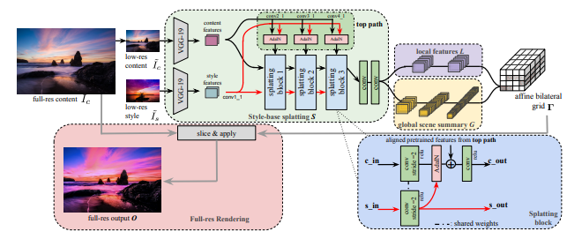
Architecture

Slide 13
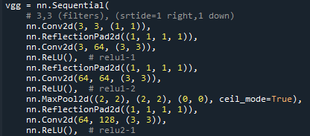
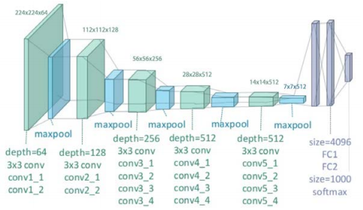
Vgg19
VGG-19 is a convolutional neural network that is 19 layers deep.

Slide 14
AdaIN

Slide 15

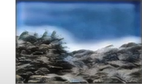
AdaIN pros & cons
+ Perform style transfer in the future space by transferring feature statistics.
+ A strong generalization ability to unseen inputs.
- Exhibit distortions on photographic content.
- Not fast enough.
Inputs AdaIN

Slide 16
Splatting blocks

Slide 17

HDRnet

Slide 18
HDRnet - continue

Slide 19
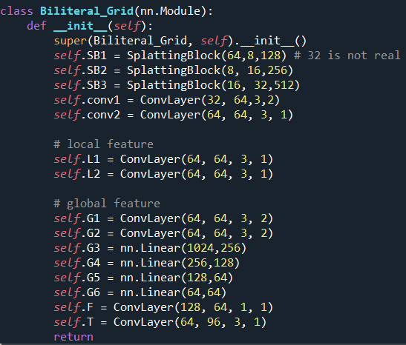
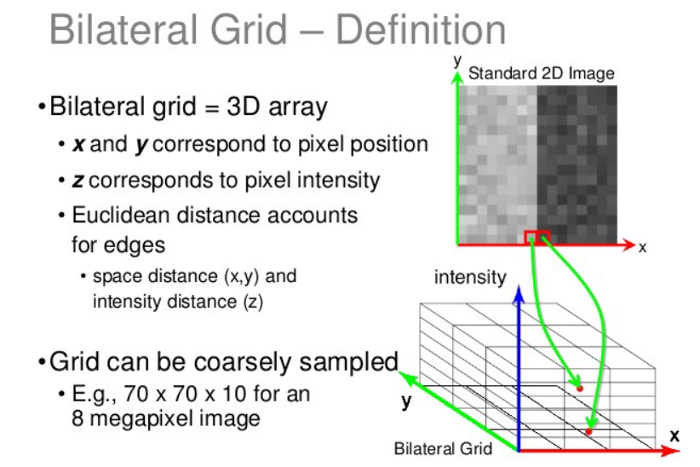
Biliteral grid

Slide 20
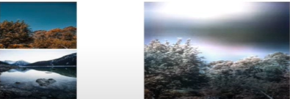
HDRnet pros & cons
+ The network is small.
+ Real-time.
+ Learn transforms that are intentionally constrained to be edge-aware.
- HDRnet does not explicitly model style transfer.
- Incapable of generalizing to unseen or adversarial inputs.
Inputs HDRnet

Slide 21
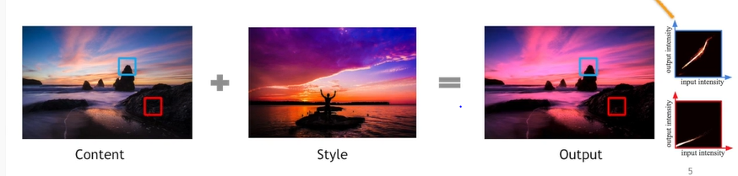
Overview
Our work unites these two lines of research (HDRnet and AdaIN).
We use a bilateral grid to represent transformation between images.
The grid can encode any image-to-image transformation given sufficient resolution.

Slide 22
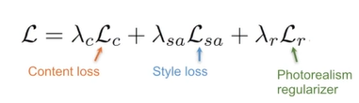
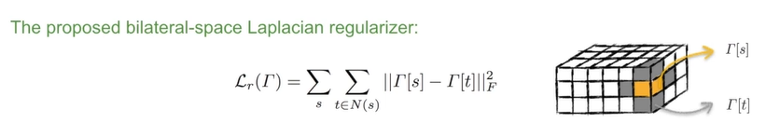
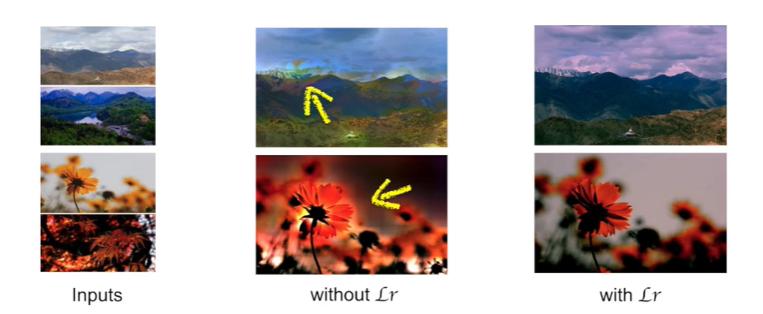
Losses

Slide 23
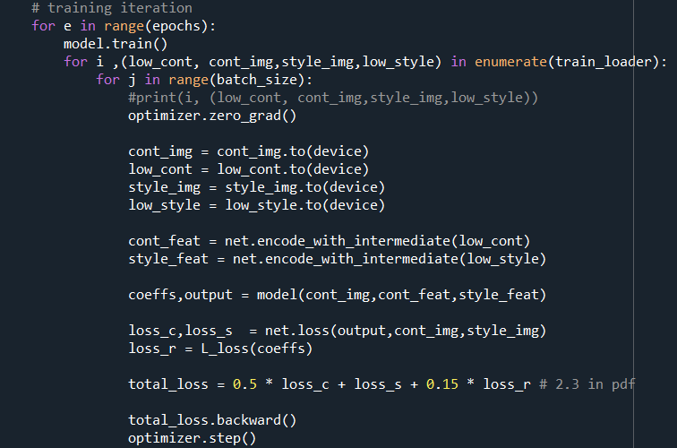
Training

Slide 24
Compare to baseline

Slide 25
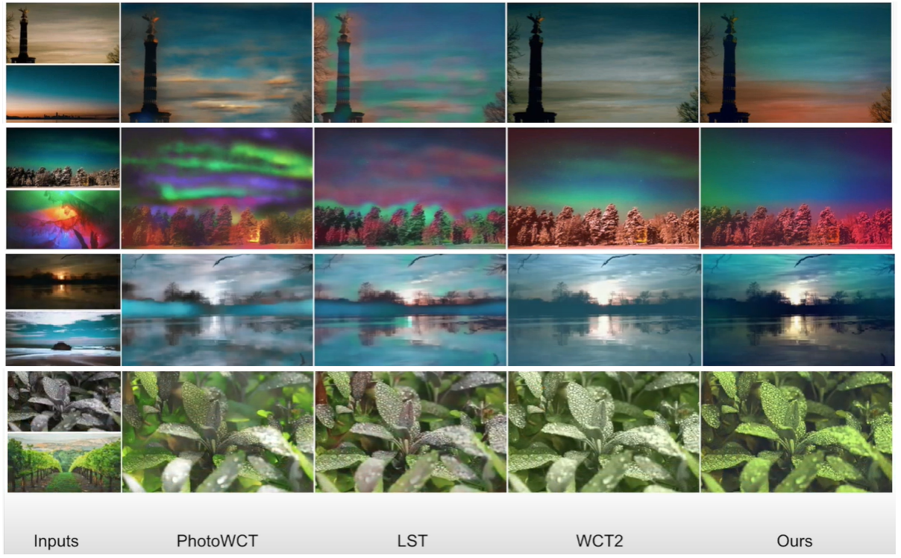
Qualitative comparison

Slide 26
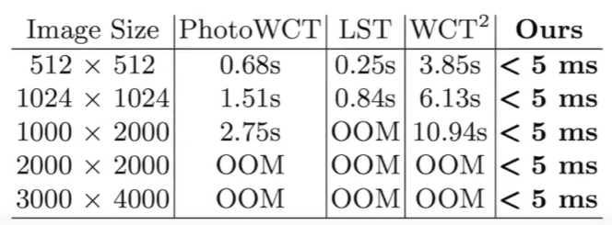
Runtime

Slide 27
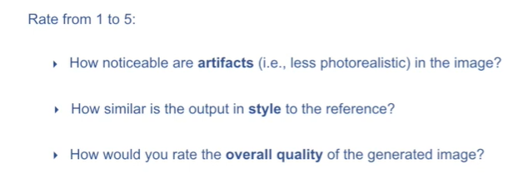
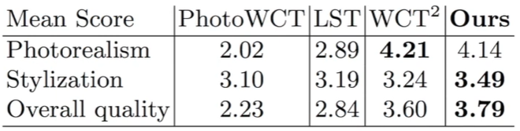
User study

Slide 28
Conclusions
Significantly faster than the state of the art.
Degrades gracefully even in extreme cases.
Runs in real-time on a smartphone.
It's fast runtime and robustness will lead to practical applications in mobile photography.
Can be improved by reducing network size and figure out how to relax the photorealism constraint.

